Slide 1
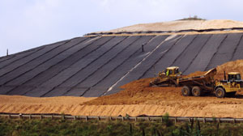

Flood Risk to Hillside Mine
Steven Sandoval
Christopher Hazel
Kyle Karshner
Adel Althawab

Slide 2
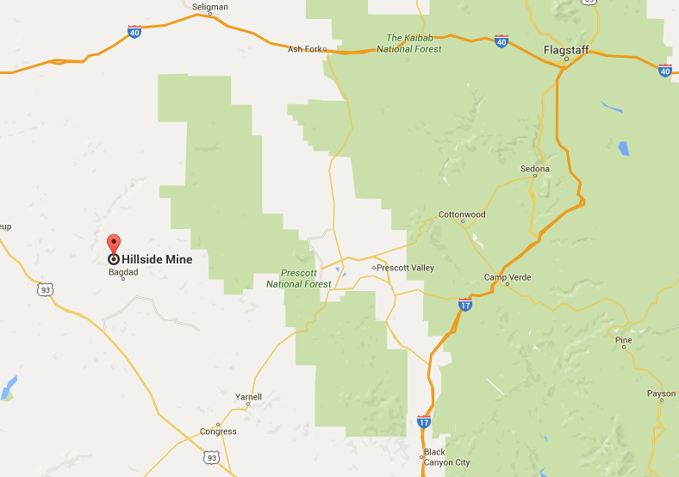
Site Location
Located in the Eureka Mining District in Yavapai County, Arizona.
5 miles north of Bagdad, Arizona along Boulder Creek
Figure 1: Site Location [1]

Slide 3
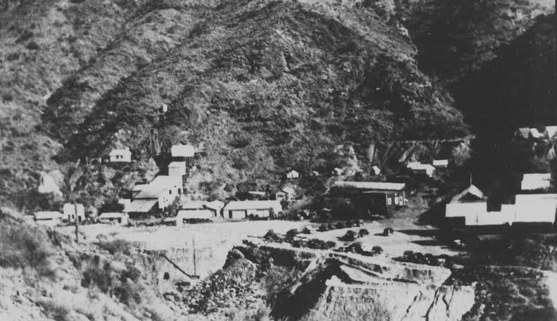
Project Background
Founded by John Lawler in 1887
  Had its own school and post office
  Closed in 1951 due to lightning strike
  Contaminates in Boulder creek
  Zinc
  Manganese
  Copper
  Cadmium
  Acid
Figure 2: Hillside Mine 1951

Slide 4
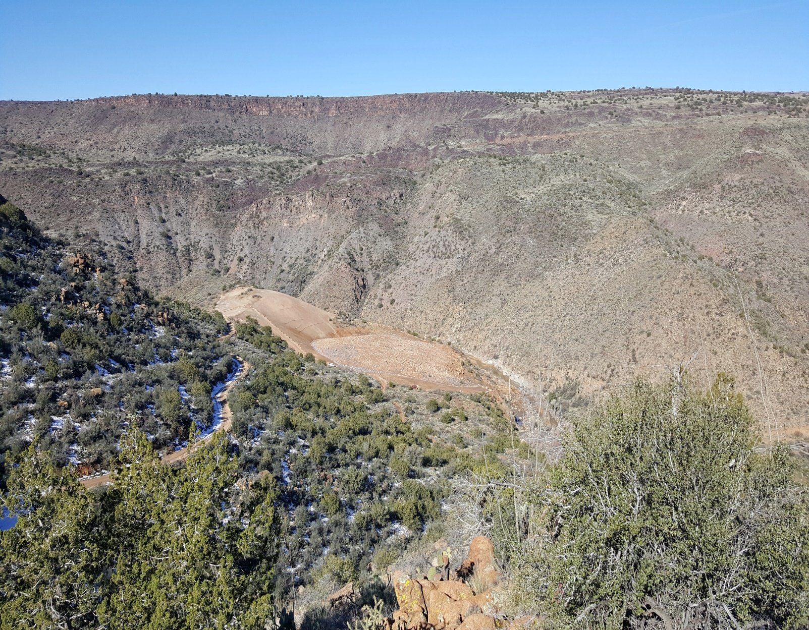
Purpose of the Project
Figure 3: Hillside Mine (2016)
  Identify and map the potential damage to the Hillside Mine waste repository cap in the event of a catastrophic flood
  500-year storm event

Slide 5
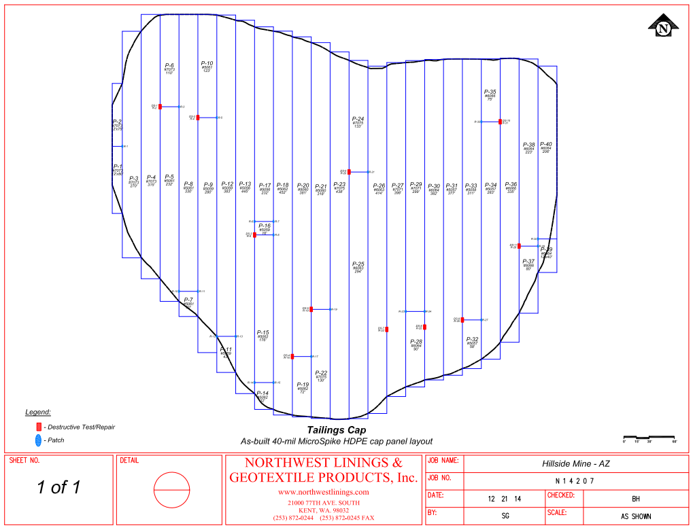
Waste Repository Cap
Cap Placement: Dec. 2014
250,000 sf
Approximately 36 in. of soil cover
Current Condition: Good
Figure 4: Drawing of Tailings Cap

Slide 6
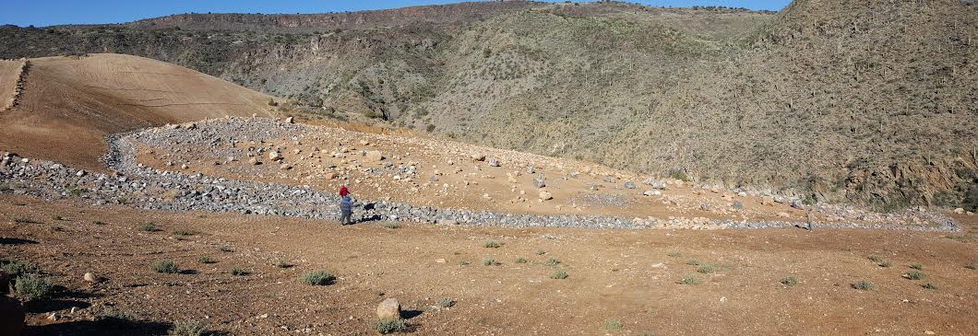
Cap Condition (Feb. 2016)
Figure 5: Hillside Mine Cap

Slide 7
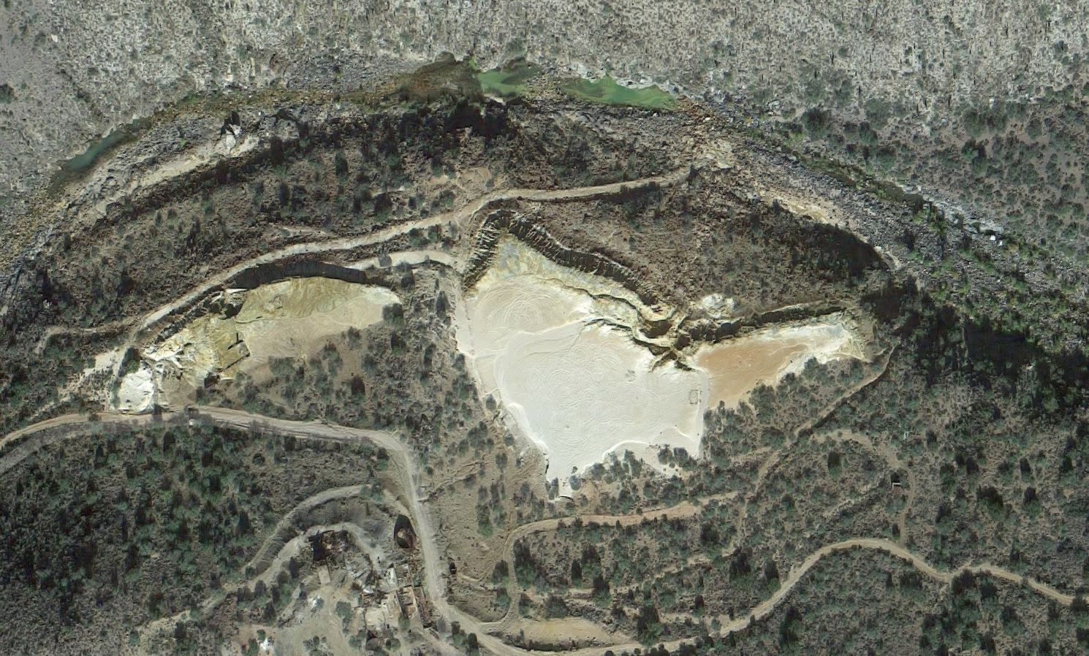
Plan View
Figure 6: Plan View

Slide 8
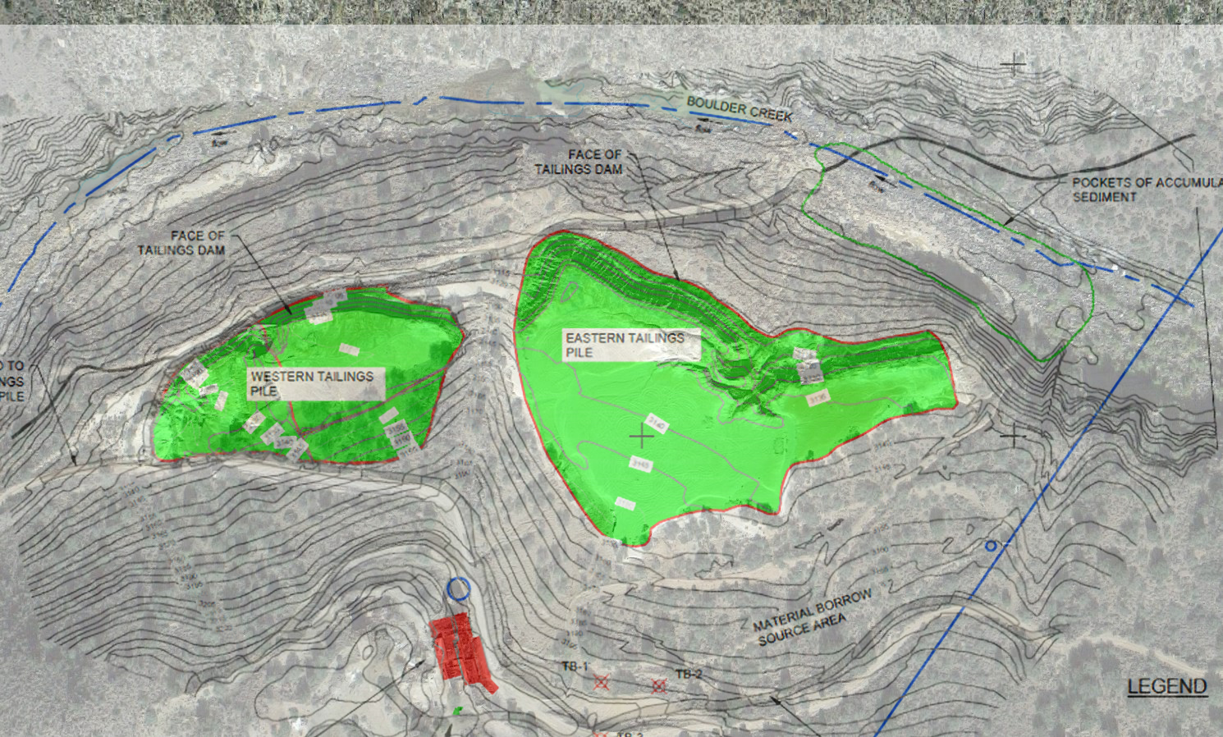
Plan View
E.O.P
B.O.P
Figure 6: Plan View

Slide 9
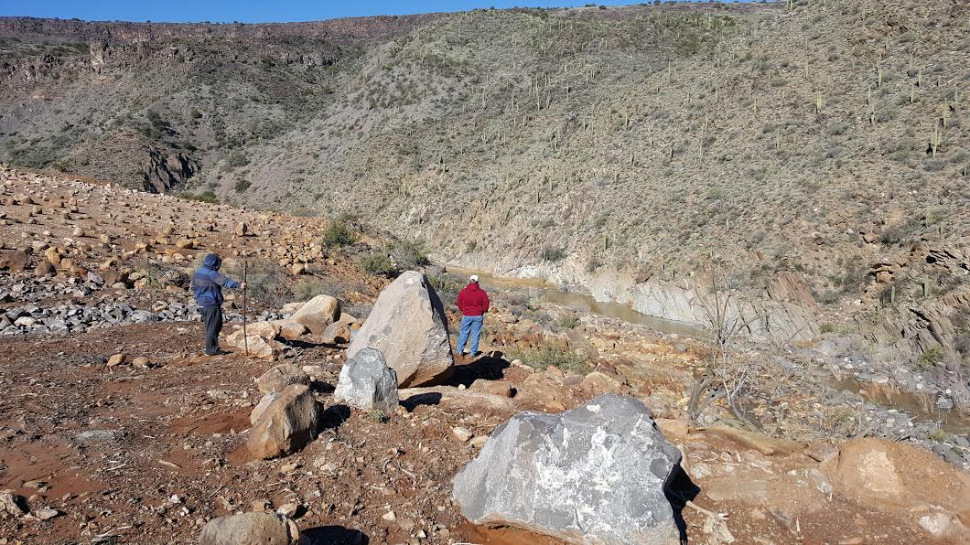
Figure 7: View of Boulder Creek from Mine Site

Slide 10
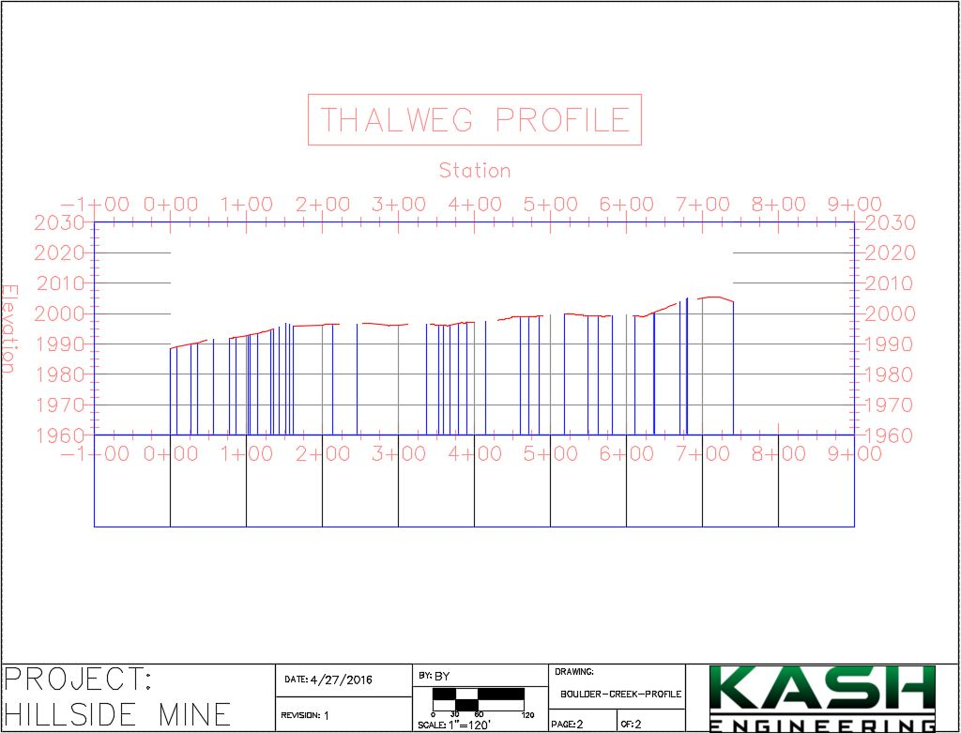
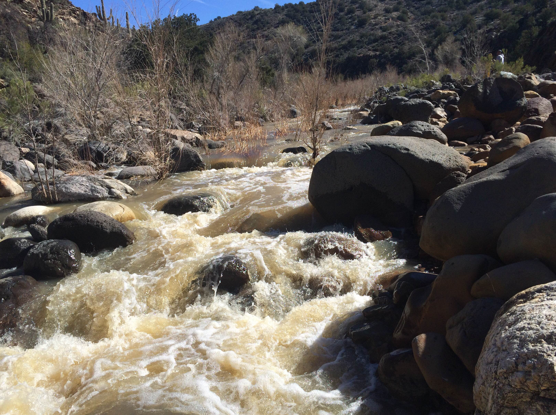
Stream Profile
Figure 8: Boulder Creek
Figure 9: Boulder Creek Profile (AutoCAD)

Slide 11
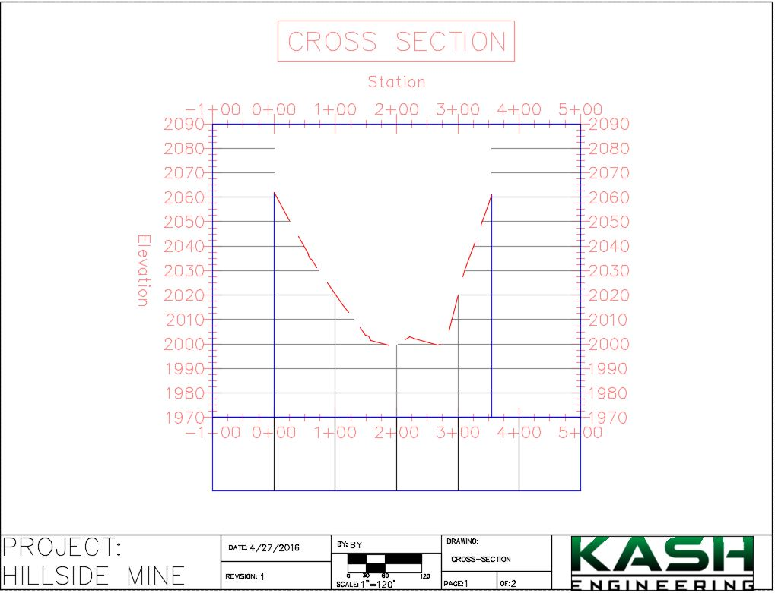
Cross Sections
Figure 10: Boulder Creek Cross Section (AutoCAD)

Slide 12
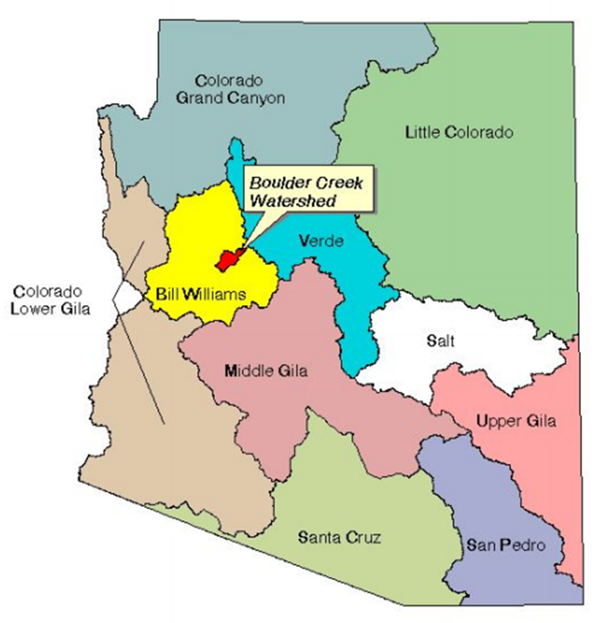
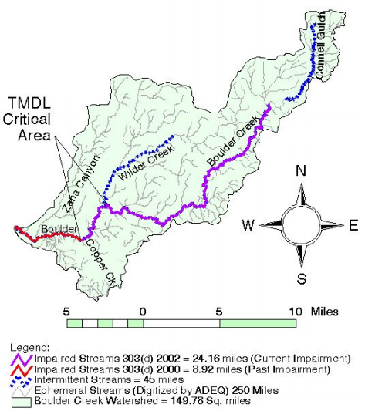
Watershed
Approx. 150 Sq. miles
Figure 11: Boulder Creek Watershed [2]
Figure 12: Arizona Watershed Map [3]

Slide 13
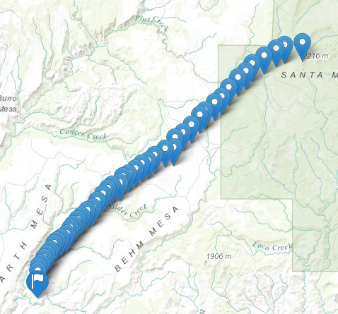
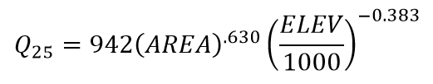
Flow Data
NFF Requirements
Average Elevation
Watershed Area
Figure 13: Boulder Creek Elevation Data

Slide 14
Flow Data
Flow using NFF Equations
Figure 14: Boulder Creek Flow
Table 1: Boulder Creek Storm Event Flows

Slide 15
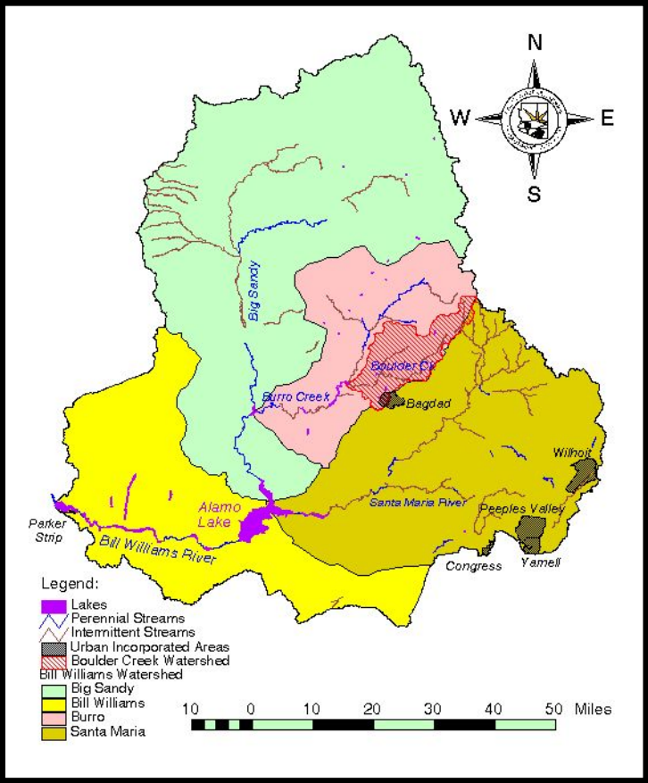
Map of Boulder and Burro Creek
AREA
Burro Creek – 600 square miles
Boulder creek – 150 square miles
Flow data adjusted for area
Figure 15: Bill Williams Watershed

Slide 16
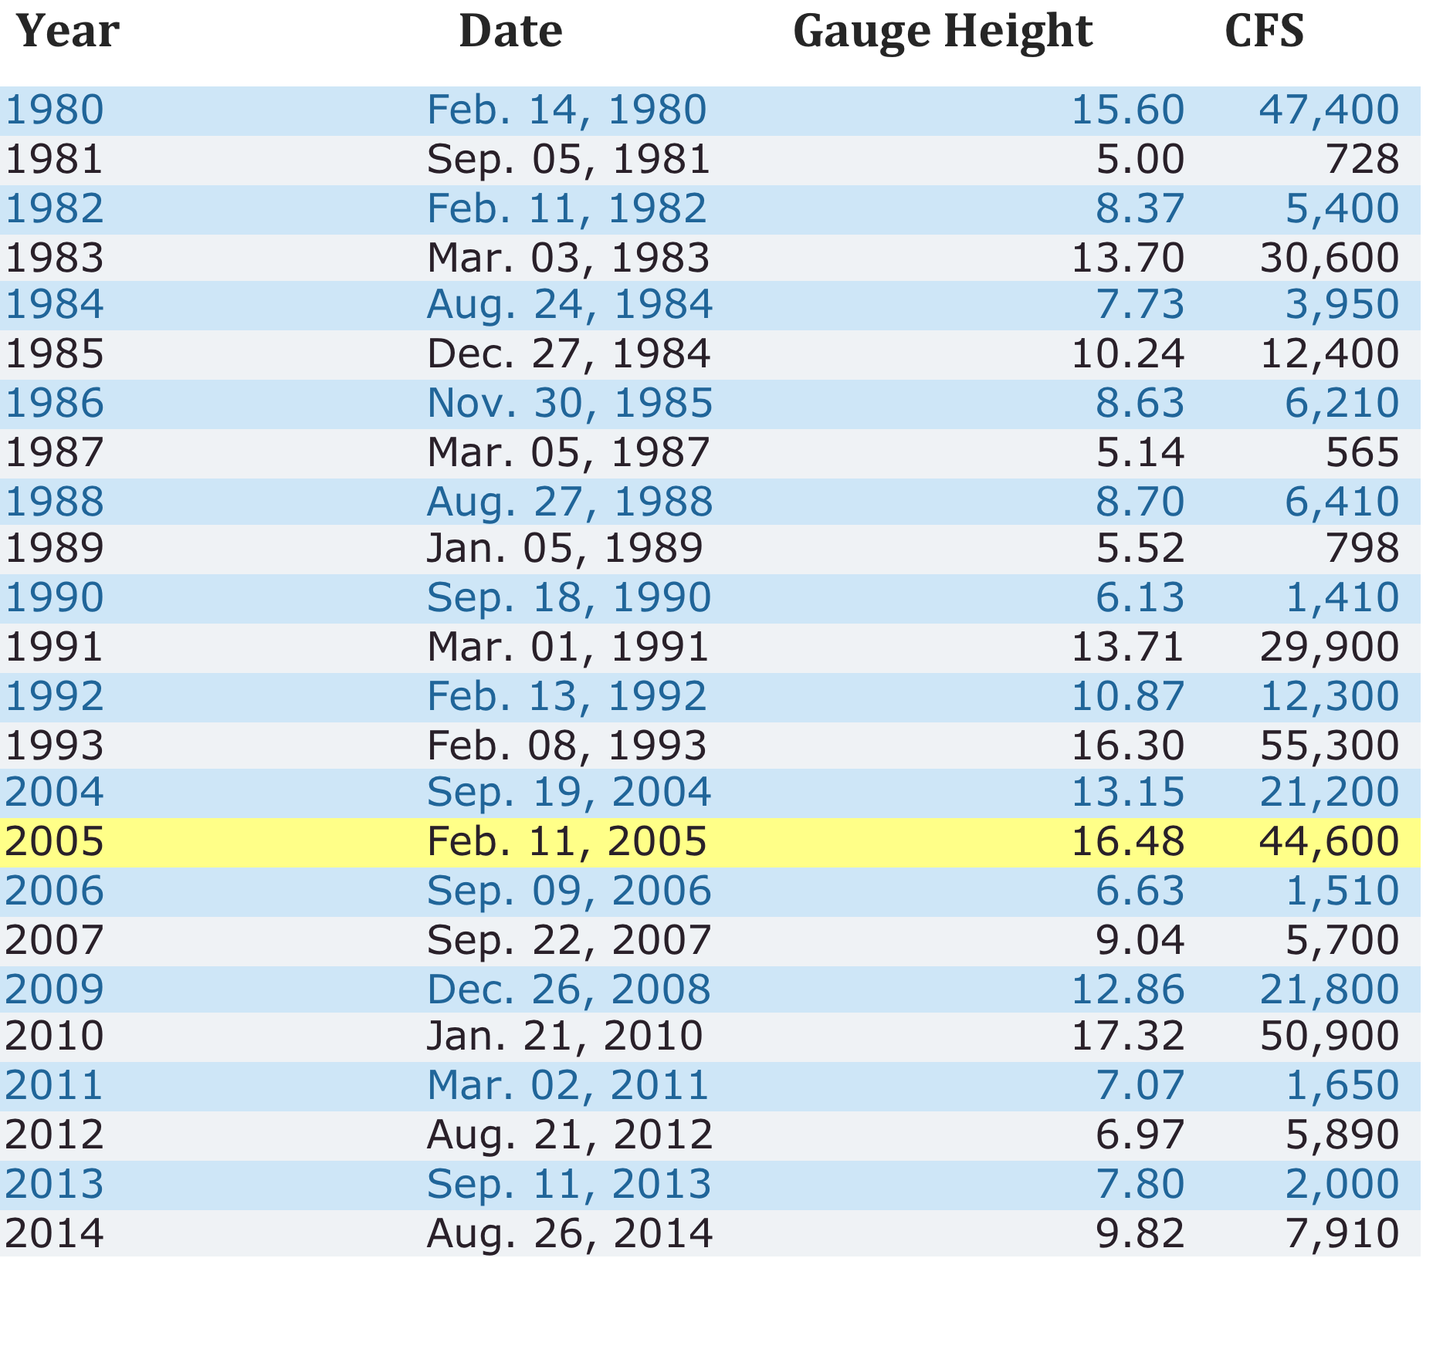
Burro Creek Flow Trends
Table 2: Burro Creek Flow Data
Figure 16: Burro Creek Peak Flows

Slide 17
Area adjusted Flow Data
Flow using Burrow Creek Stream Gage
Table 3: Burro Creek Flow Data
Figure 17: Burro Creek Flow Data

Slide 18
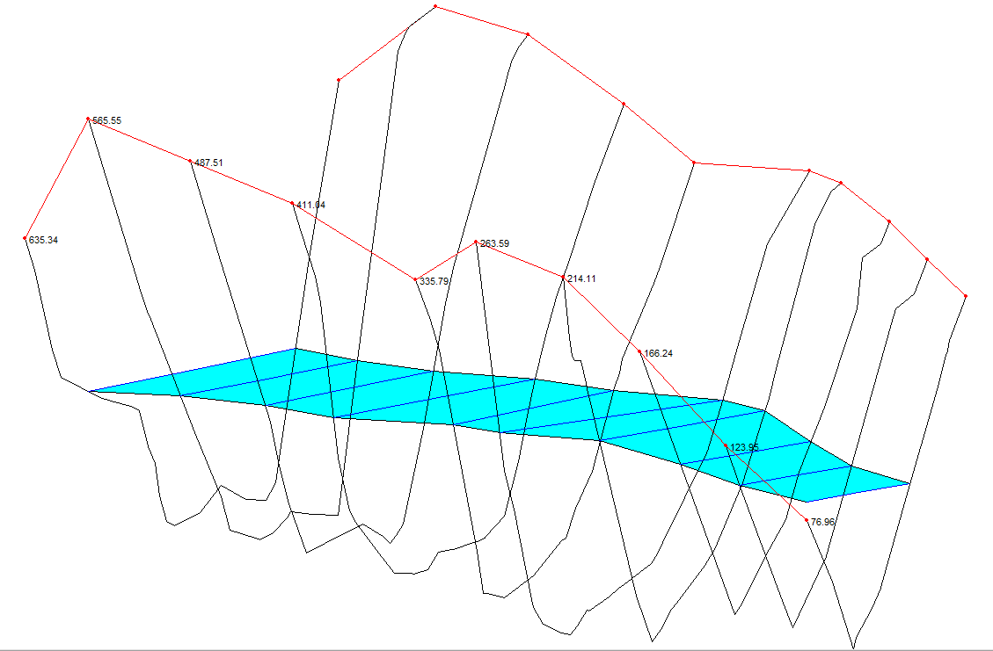
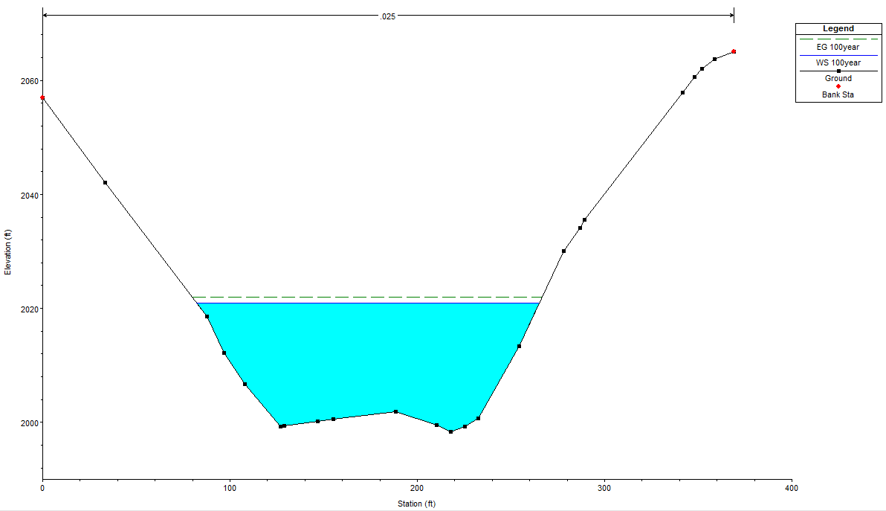
HEC-RAS
100 Year Flow
24,000 cfs

Slide 19
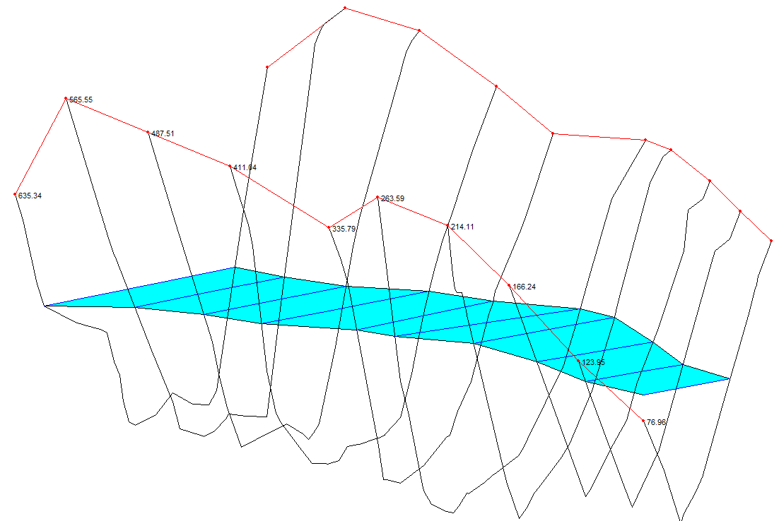
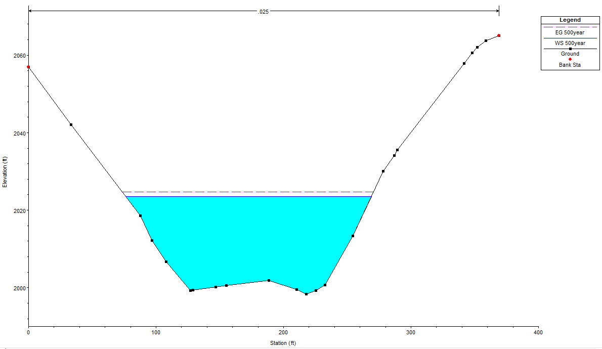
HEC-RAS
500 Year Flow
30,000 cfs

Slide 20

Schedule
Green Highlight
Completed on Time
Red Highlight
Completed Late

Slide 21
Cost Analysis
 |  |  | Tasks
1.0 Personal |  |  | 1 |  | 2 |  | 3 |  | 4 |  | 5
Title | Rate (dollar/hr) |  | Data Collection (hr) |  | Site Inspection (hr) |  | Surveying (hr) |  | Hydraulic Modeling (hr) |  | Project Mangement (hr) |  | Total Hours |  | Cost
 |  |  | Proj. | Actual | Proj. | Actual | Proj. | Actual | Proj. | Actual | Proj. | Actual | Projected | Actual | Projected | Actual
Senior engineer | 145 |  |  |  | 60 | 10 |  |  |  |  | 100 | 50 | 160 | 60 | $23,200.00 | $8,700.00
Project engineer | 108 |  | 30 | 30 | 60 | 10 | 50 | 10 | 30 | 30 |  | 20 | 170 | 100 | $18,360.00 | $10,800.00
Surveyor | 78 |  | 20 | 25 | 40 | 10 | 70 | 30 |  |  |  |  | 130 | 65 | $10,140.00 | $5,070.00
Hydrology analyst | 56 |  |  | 40 | 10 | 10 | 30 | 10 | 100 | 40 |  |  | 140 | 100 | $7,840.00 | $5,600.00
 |  |  |  |  |  |  |  |  |  |  |  | Total: | 600 | 325 | $59,540.00 | $30,170.00
2.0 Reimbursed expenses |  |  | Projected |  | Actual
Travel | $0.55/mile |  | 1280 miles |  | 400 miles |  |  |  |  |  |  |  |  |  | $704.00 | $220.00
Hotel | $90/room |  | 3 nights |  | 0 |  |  |  |  |  |  |  |  |  | $540.00 | $0.00
Per-diem | $60/person |  | 3 days |  | 0 |  |  |  |  |  |  |  |  |  | $720.00 | $0.00
Rental vehicle | $55/day |  | 3 days |  | 1 day |  |  |  |  |  |  |  |  |  | $165.00 | $55.00
 |  |  |  |  |  |  |  |  |  |  |  |  |  | Total: | $61,669.00 | $30,445.00

Slide 22
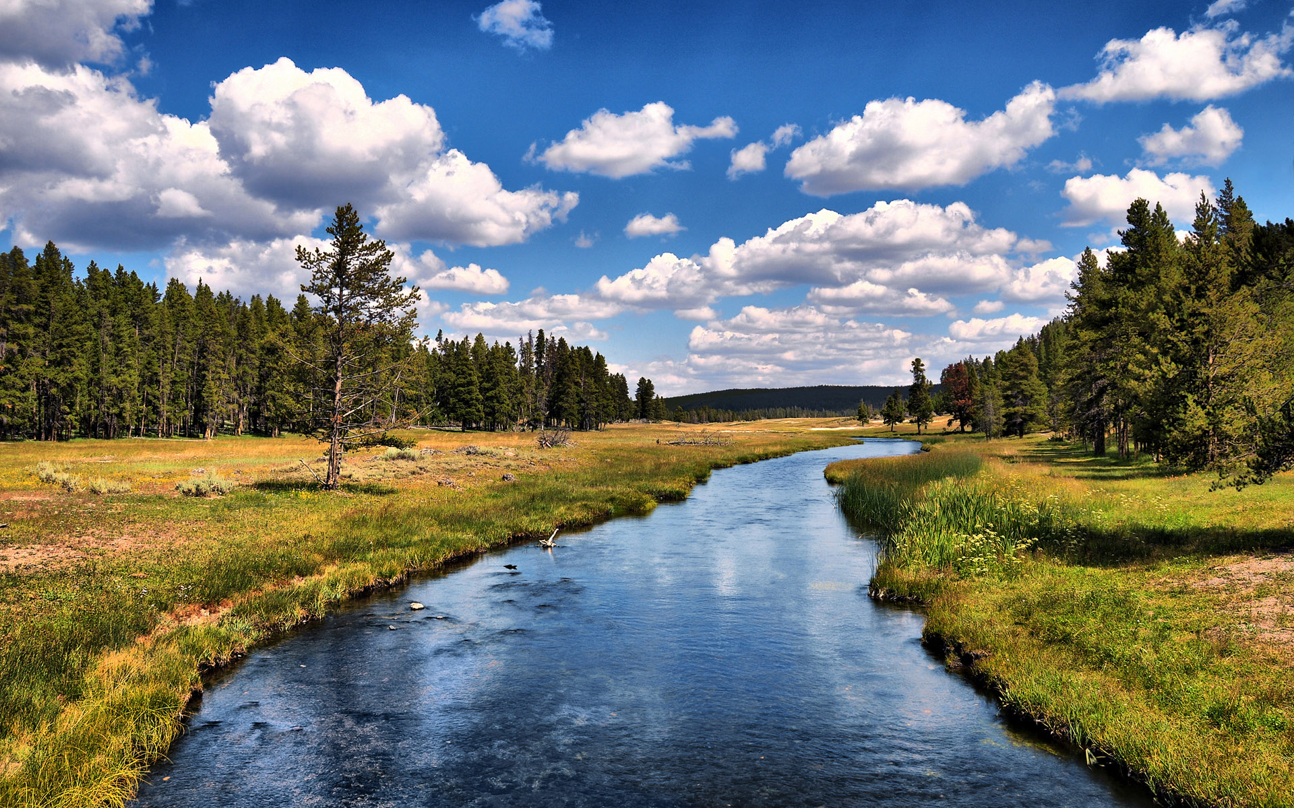
Conclusion
500 Year flow will not overbank into the cap
Energy from high flow could cause an undercut
Slope stabilization could be beneficial

Slide 23

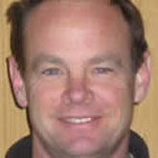
Thank You
Figure 12: Boulder Creek
Special Thanks:
Eric Zielske
Wilbert Odem

Slide 24
References
[1] https://www.google.com/maps
[2] http://pubs.usgs.gov/circ/circ1284/pdf/circ1284.pdf
[3] http://www.azwater.gov/AzDWR/StatewidePlanning/ WaterAtlas/UpperColoradoRiver/Hydrology/BillWilliams.htm
[4] D. Feldman, Hydrologic Modeling System: HEC-HMS: US Army Corps of Engineers, Institute for Water Resources, Hydrologic Engineering Center, 2001.
[5] Arizonaaccessmap.com
[6] AutoCAD Civil 3D

